Slide 1
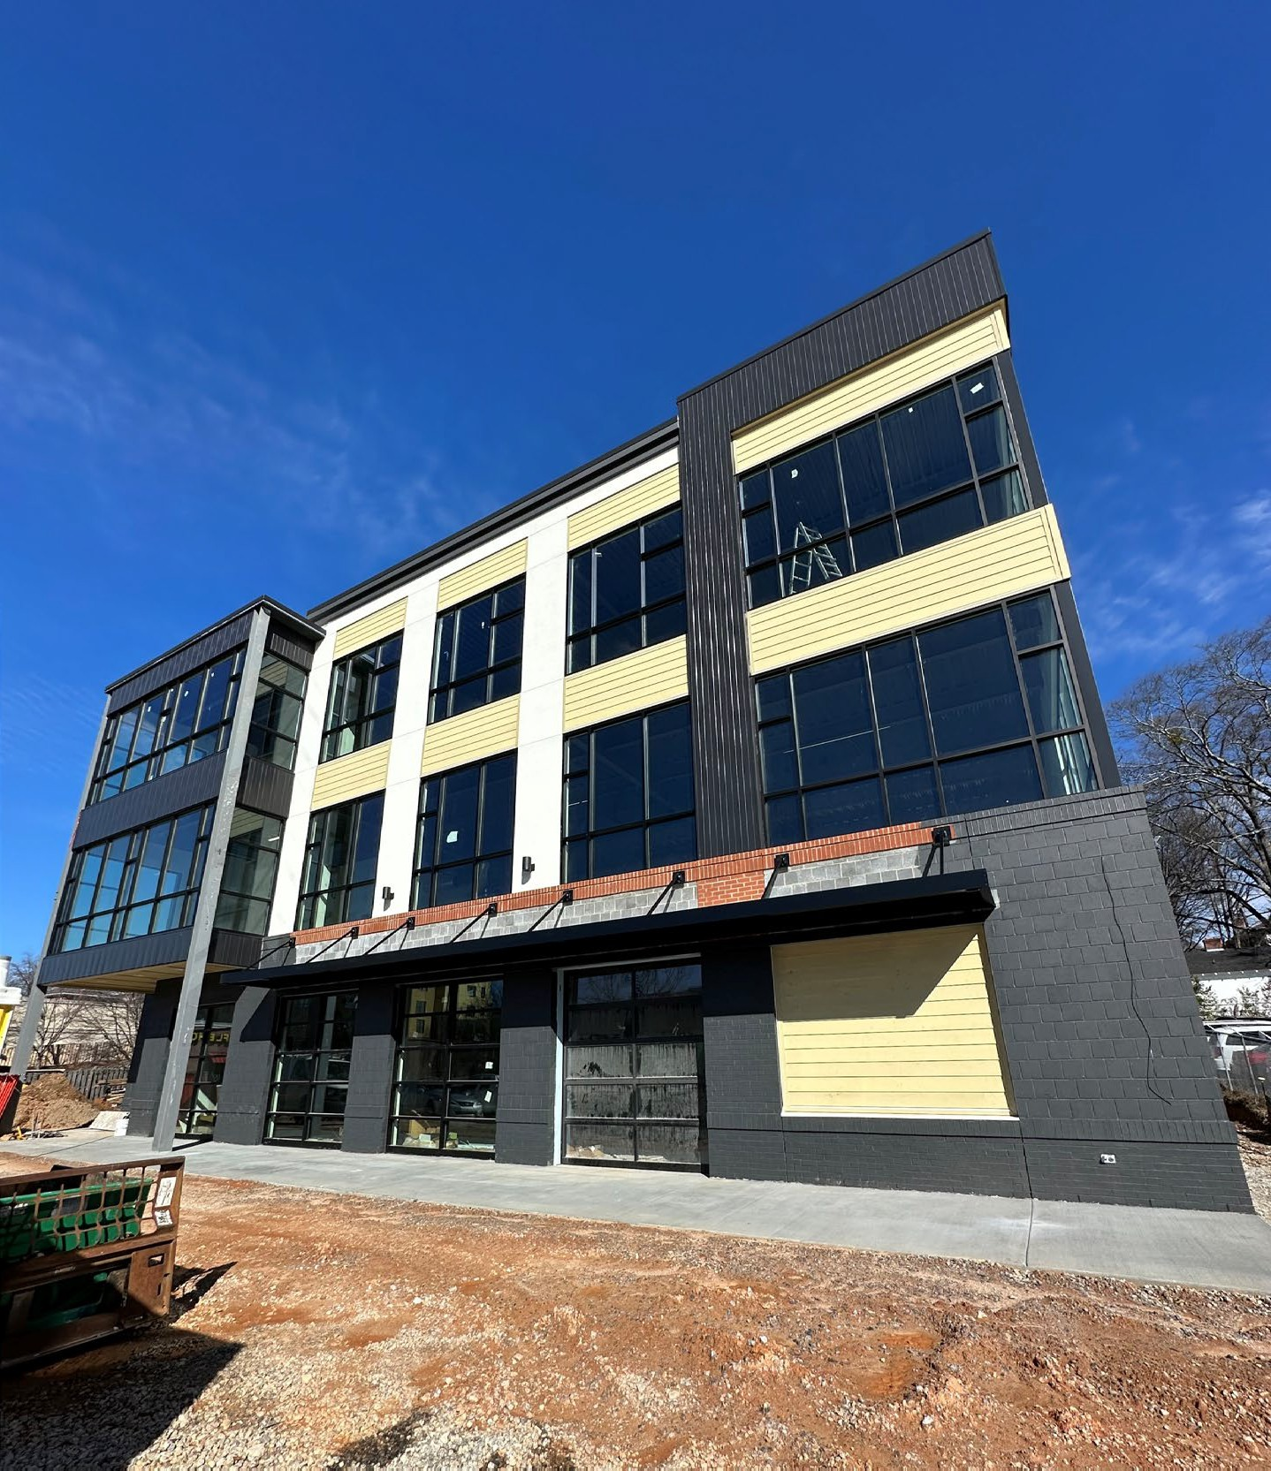
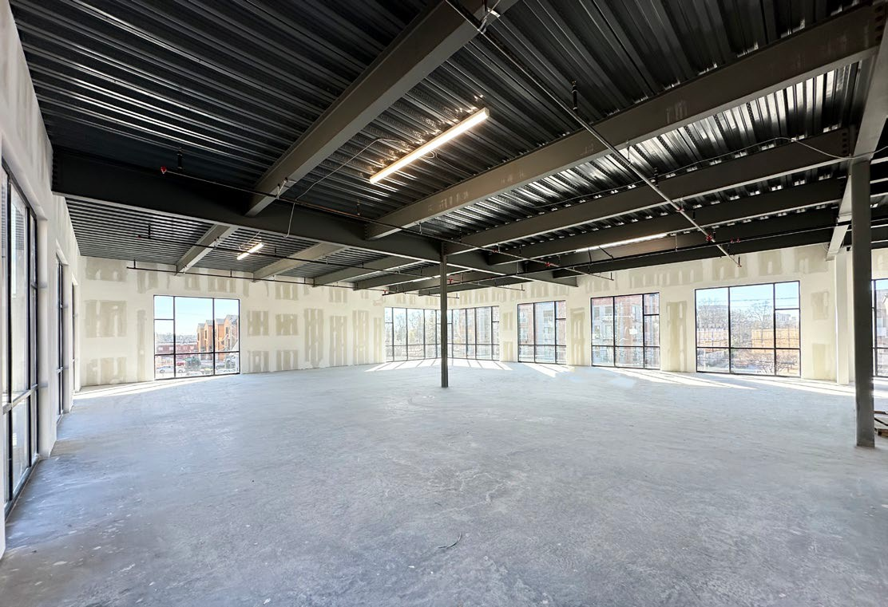
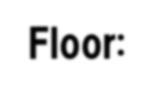
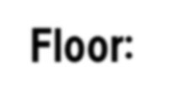
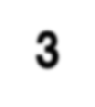
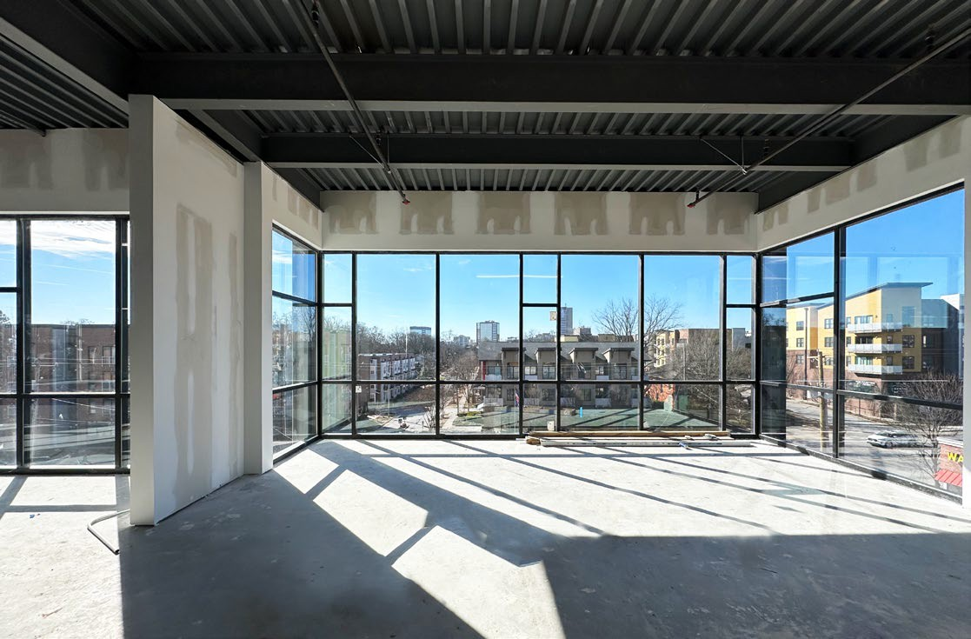
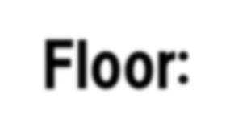
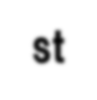
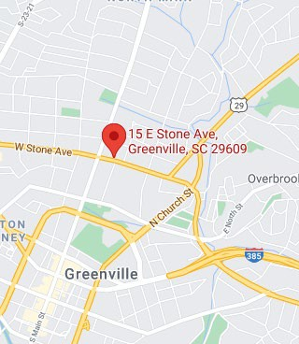
OFFICE/RETAIL SPACE
FOR LEASE
±7,060 SF
17 E. STONE AVE GREENVILLE, SC 29609
COMMERCIAL REAL ESTATE SALES, LEASING, & INVESTMENTS
500 E. North St. | Suite F | Greenville, SC 29601
1st Floor:
2nd Floor: Available 3rd Floor: Available
1st Floor: LEASED
NEW MULTI-TENANT BUILDING ON E. STONE AVE
LEASE RATE:
CONTACT AGENT
Brand new development on E. Stone Ave. Downtown Greenville
Features expansive views of Downtown and the North Main community
Multi-Tenant layout features Restaurant, Outdoor Green Space, Office Space, etc.
Elevator access to all floors and on-site parking
Ideal location in Downtown which services the North Main Community
Unique opportunity to tailor your space (within a specific set of guidelines)
before construction is completed
Est. Delivery: Q1 2024
1st Floor: Leased ±3,099 SF | Restaurant Space Tenant:
2nd Floor: Available ±3,523 SF | Class A Office Space, Retail, Medical, Etc.
3rd Floor: Available ±3,537 SF | Class A Office Space, Retail, Medical, Etc.
ZACH HINES | (864) 918-9944 ZHINES@SPENCERHINES.COM
CAMERON SMITH | (864) 915-9360 CAMERON@SPENCERHINES.COM

Slide 2
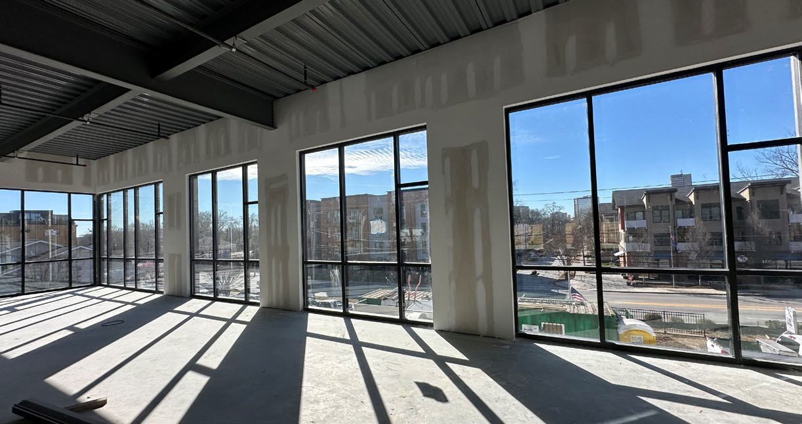
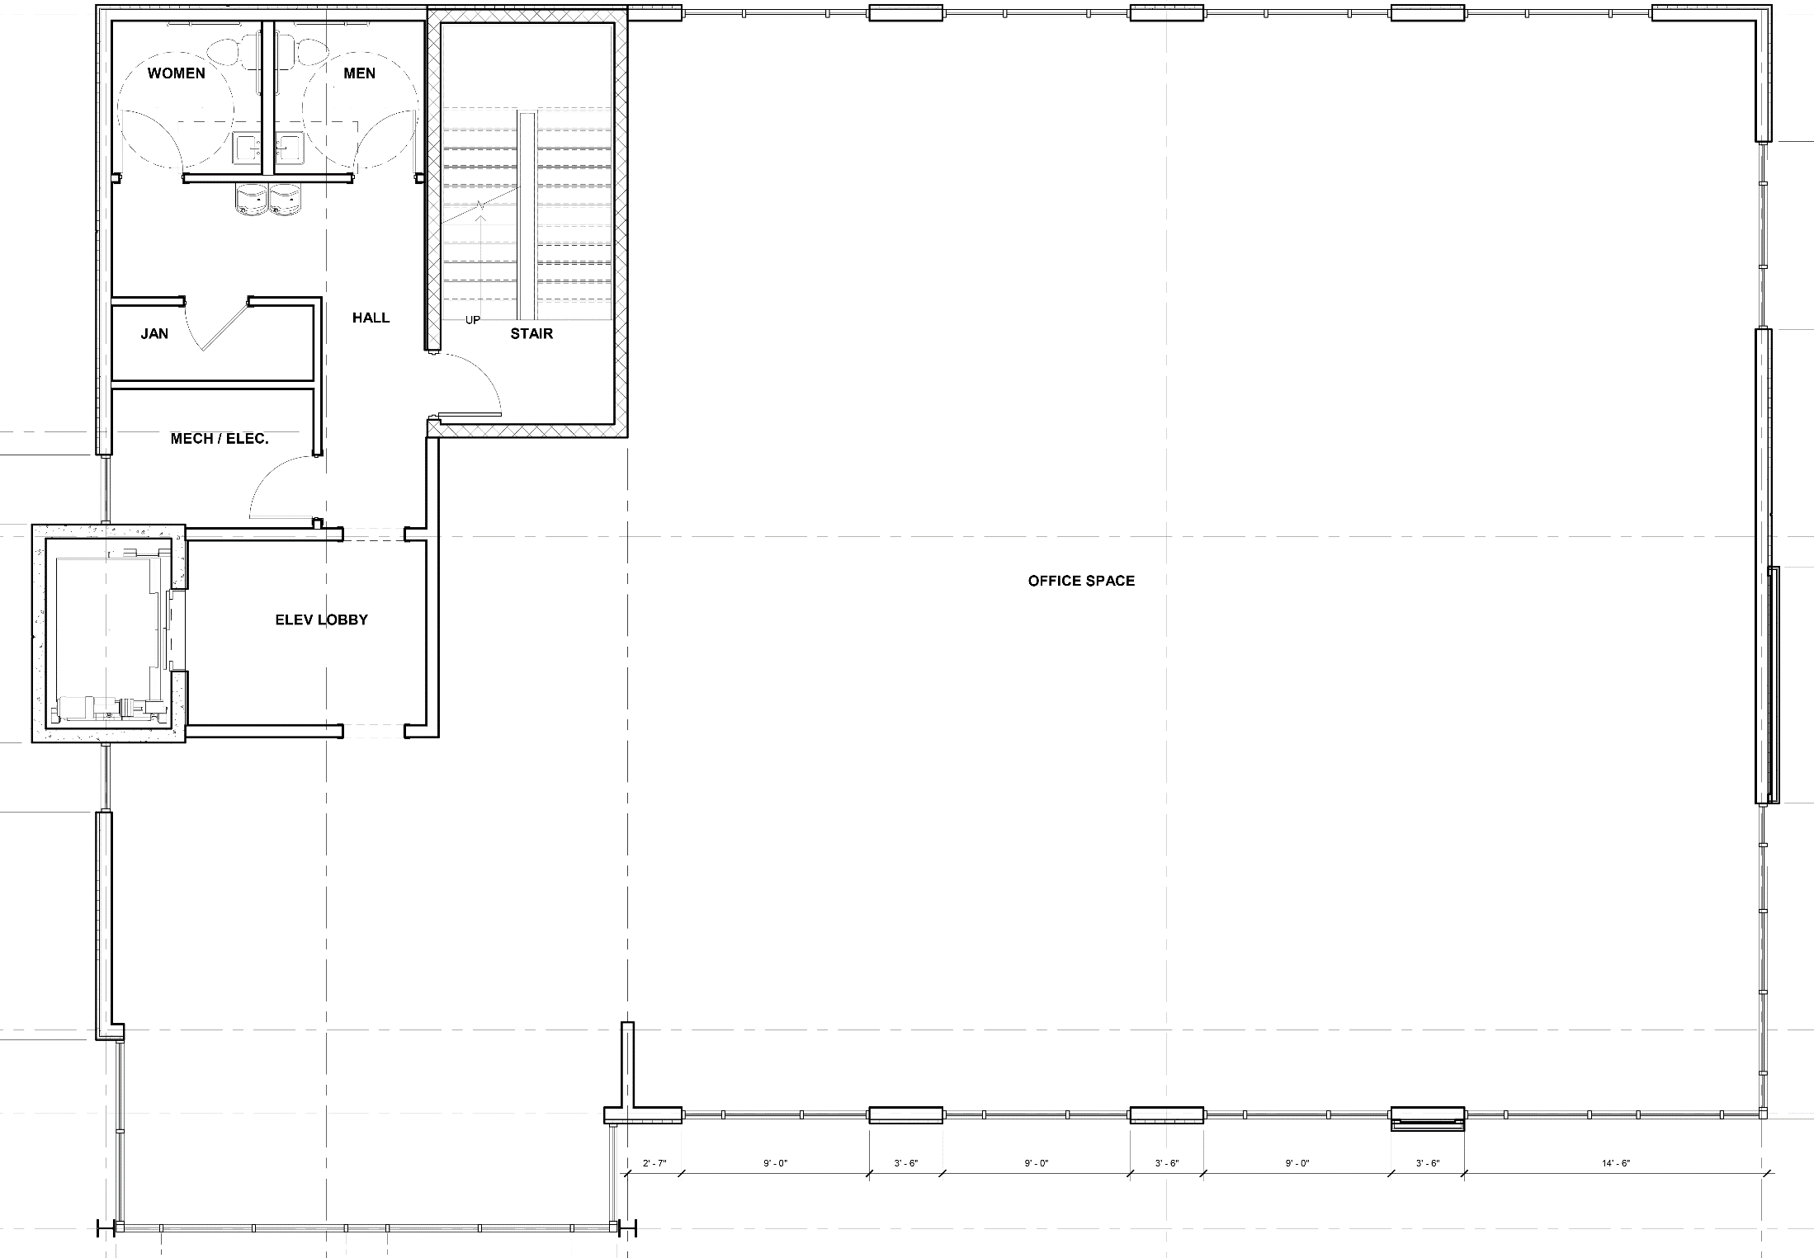
OFFICE/RETAIL SPACE
FOR LEASE
±7,060 SF
17 E. STONE AVE GREENVILLE, SC 29609
COMMERCIAL REAL ESTATE SALES, LEASING, & INVESTMENTS
500 E. North St. | Suite F | Greenville, SC 29601
SECOND FLOOR:
±3,523 SF
Class A - Office Space, Retail, Medical, etc.
Features an abundance of natural light with floor to ceiling windows
Elevator and stairwell access
Exterior signage available
Features expansive city views of Downtown Greenville
Able to be subdivided
Office layout able to be customized for tenant’s needs (bathroom/elevator/stairs unable to be altered)
ZACH HINES | (864) 918-9944 ZHINES@SPENCERHINES.COM
CAMERON SMITH | (864) 915-9360 CAMERON@SPENCERHINES.COM

Slide 3
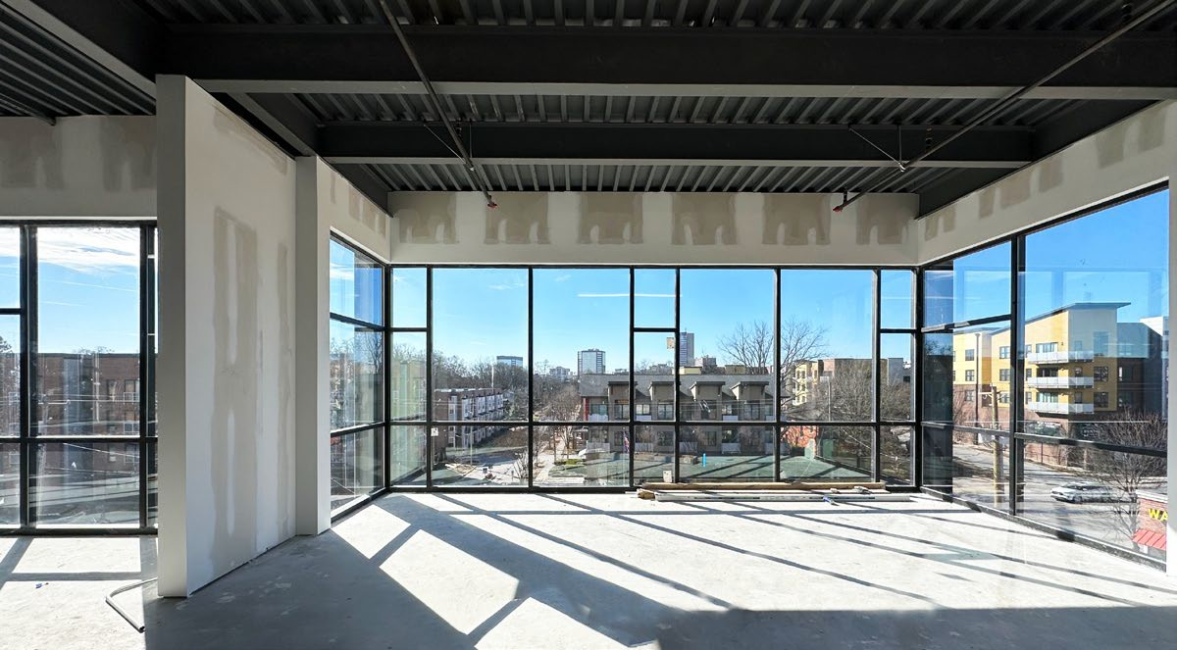
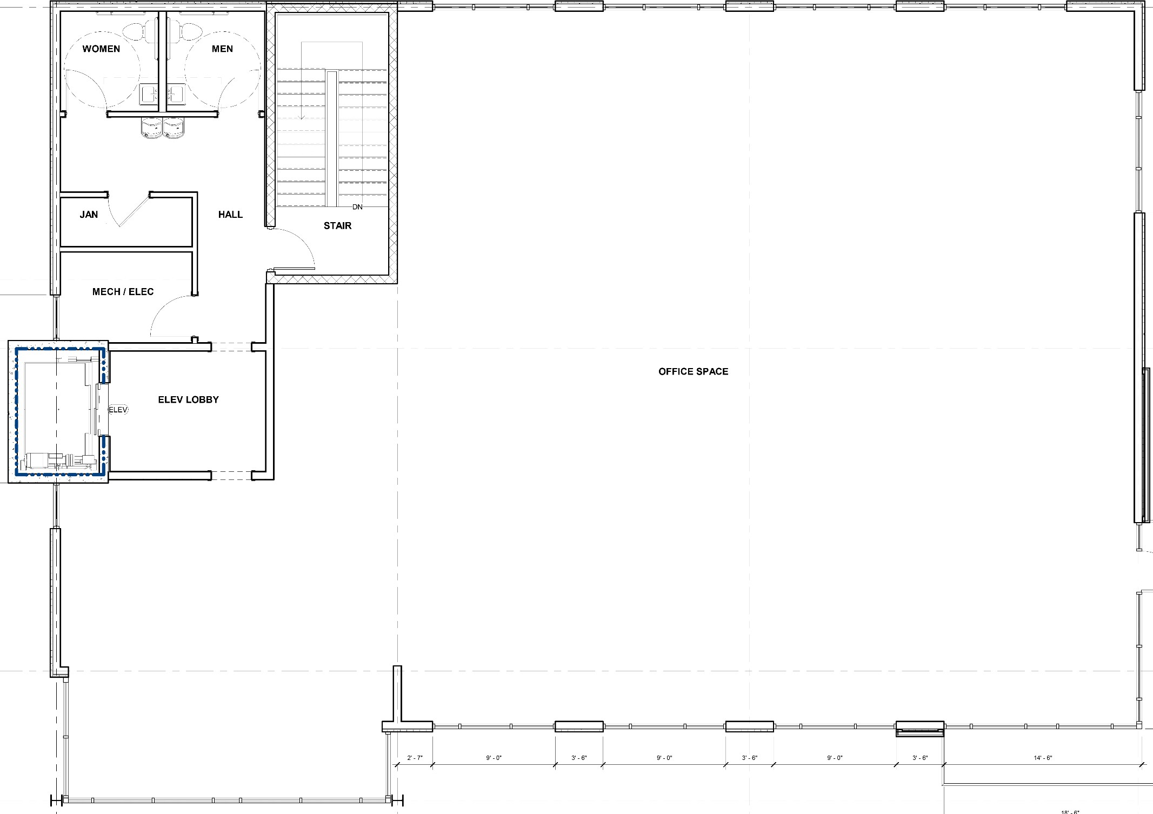
OFFICE/RETAIL SPACE
FOR LEASE
±7,060 SF
17 E. STONE AVE GREENVILLE, SC 29609
COMMERCIAL REAL ESTATE SALES, LEASING, & INVESTMENTS
500 E. North St. | Suite F | Greenville, SC 29601
THIRD FLOOR:
±3,537 SF
Class A - Office Space, Retail, Medical, etc.
Features an abundance of natural light with floor to ceiling windows
Elevator and stairwell access
Features expansive city
views of Downtown Greenville
Exterior signage available
Able to be subdivided
Office layout able to be customized for tenant’s needs (bathroom/elevator/stairs unable to be altered)
ZACH HINES | (864) 918-9944 ZHINES@SPENCERHINES.COM
CAMERON SMITH | (864) 915-9360 CAMERON@SPENCERHINES.COM

Slide 4
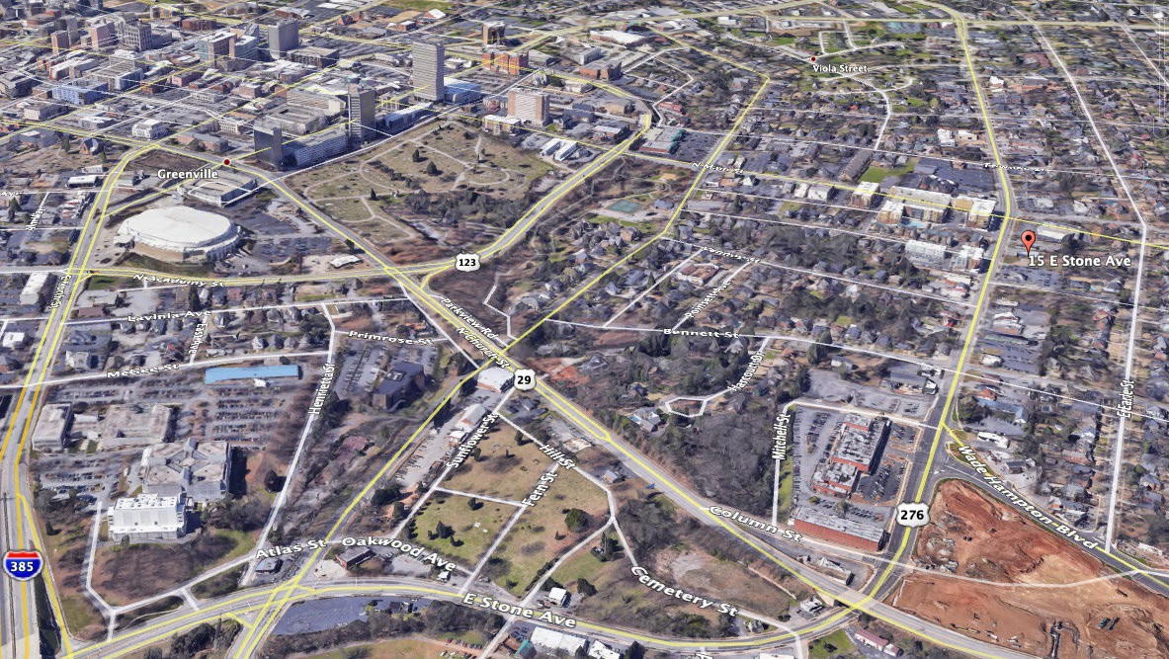
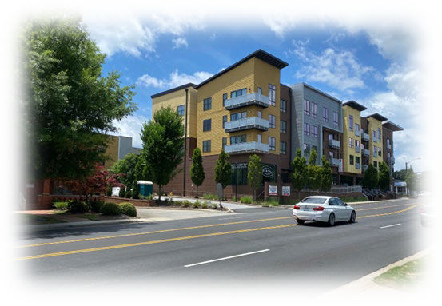
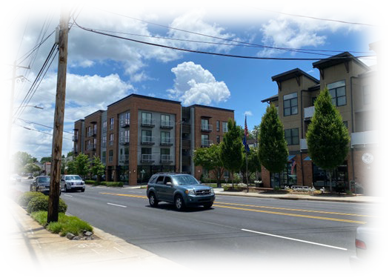
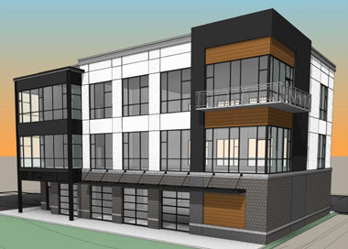
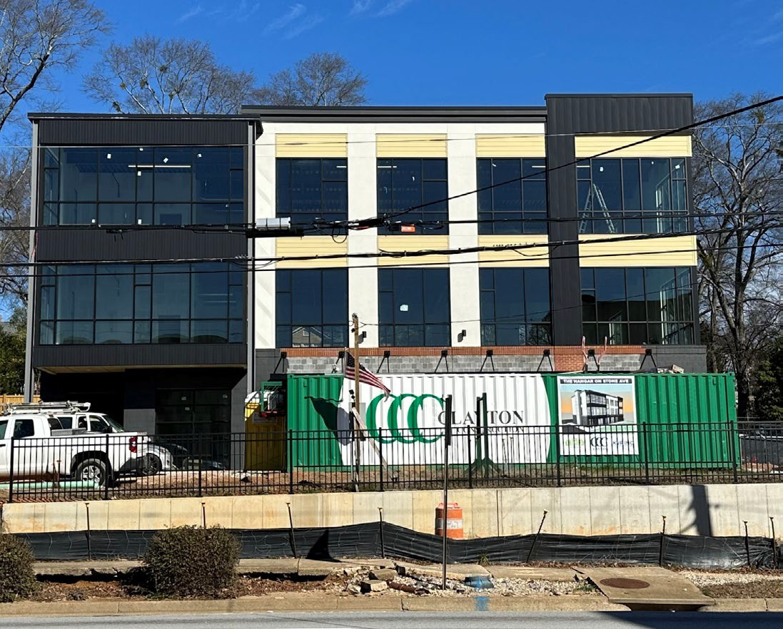
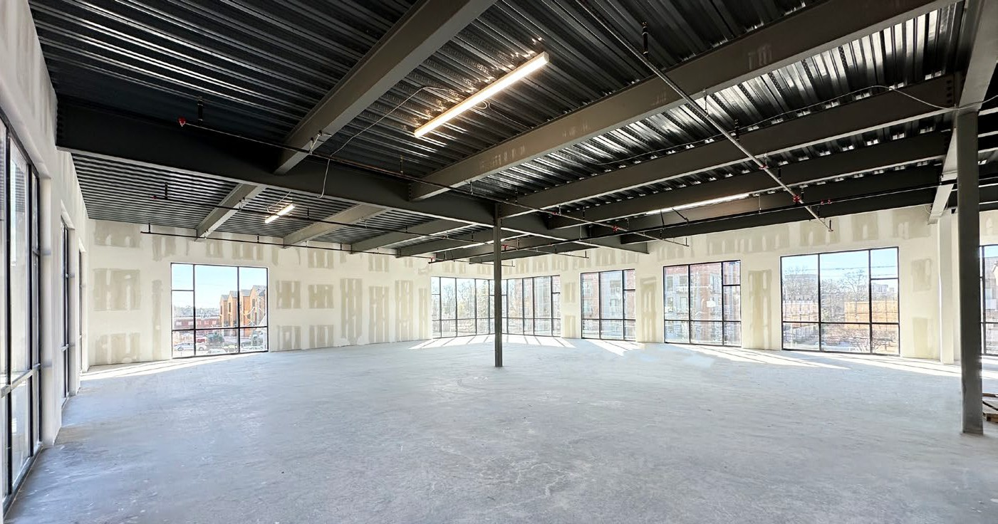
OFFICE/RETAIL SPACE
FOR LEASE
±7,060 SF
17 E. STONE AVE GREENVILLE, SC 29609
COMMERCIAL REAL ESTATE SALES, LEASING, & INVESTMENTS
500 E. North St. | Suite F | Greenville, SC 29601
LOCATION
Across from Main and Stone apartment community and steps from N. Main Street and Stone Ave. intersection and the heart of Downtown Greenville
Main and Stone Apartment Community
Main and Stone Apartment Community
SITE PHOTOGRAPHY
ZACH HINES | (864) 918-9944 ZHINES@SPENCERHINES.COM
CAMERON SMITH | (864) 915-9360 CAMERON@SPENCERHINES.COM

